Slide 1

In the name of Allah (God), the most beneficent
and most merciful
1
Notes:
1

Slide 2
First Progress Presentation
DATABOT
Group Members
Muhammad Sanan (Cu-481-2018)
Mustafa Haider (Cu-470-2018)
Hamza Ayaz (Cu-524-2018)
Project Supervisor
Ma’am Zainab Jamil

Slide 3
CONTENTS
Suggestion (Regarding Proposal defense)
Progress from the defense presentation
SRS (Software Requirements Specification)
Advance Block diagram
Programming initiative
Project Simulation/Tools
Time Line
References
3
Notes:
3

Slide 4
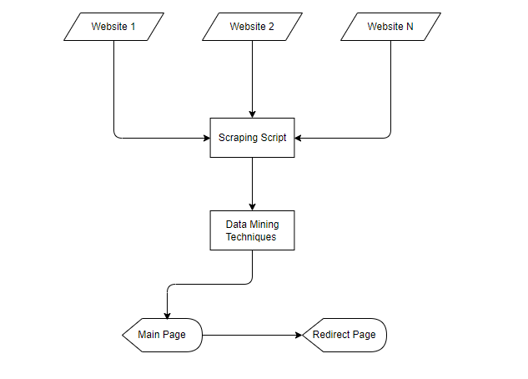
Block Diagram (Proposal Defense)
4
Notes:
4

Slide 5
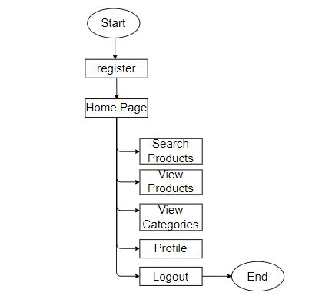
Block Diagram
5
Notes:
5

Slide 6
Progress from the defense presentation
Requirement Gathering (Completed)
Design (Completed)
Implementation (In Progress)
Deployment (Remaining)
Report Writing (Remaining)
6
Notes:
6

Slide 7
Software Requirements Specification
Functional Requirements
User can registered them self and login to the system.
User is allow to update their profile information.
Third party products integration.
User can see all the products that are coming from APIs.
Display detail information of the selected product.
Related Products has been shown with selected product.
If user buy product that will redirected to their original website.
Mostly products will be shown on the basis of user gender.
User can search products.
Products Categorization.
User can filter the products on the basis of gender, brand, price and category.
7
Notes:
7

Slide 8
Software Requirements Specification
Non-Functional Requirements
Security (Protected from XSS, SQL injection)
Availability (using Netlify and Heroku Cloud Systems)
Usability
Portability(Android OS, Web browsers)
Maintainability (using GIT to maintain the system)
8
Notes:
8

Slide 9
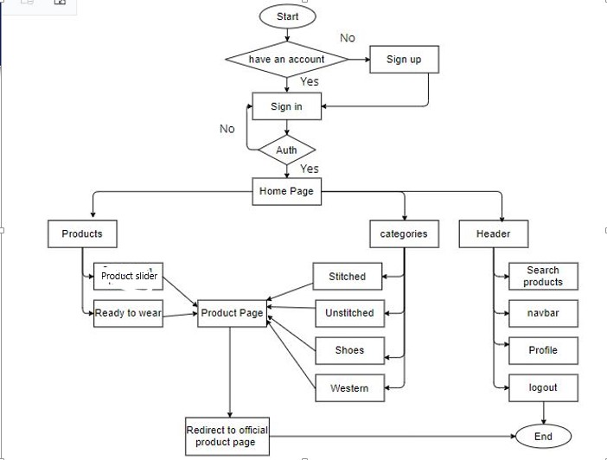
Detailed Flow Chart
9
Notes:
9

Slide 10
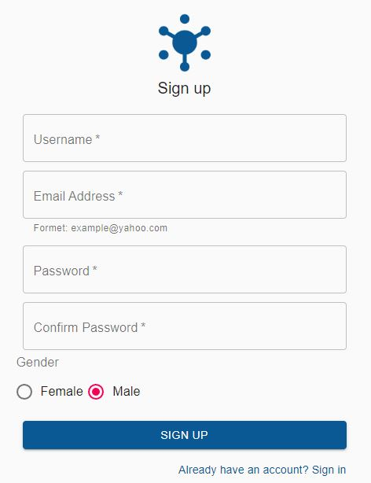
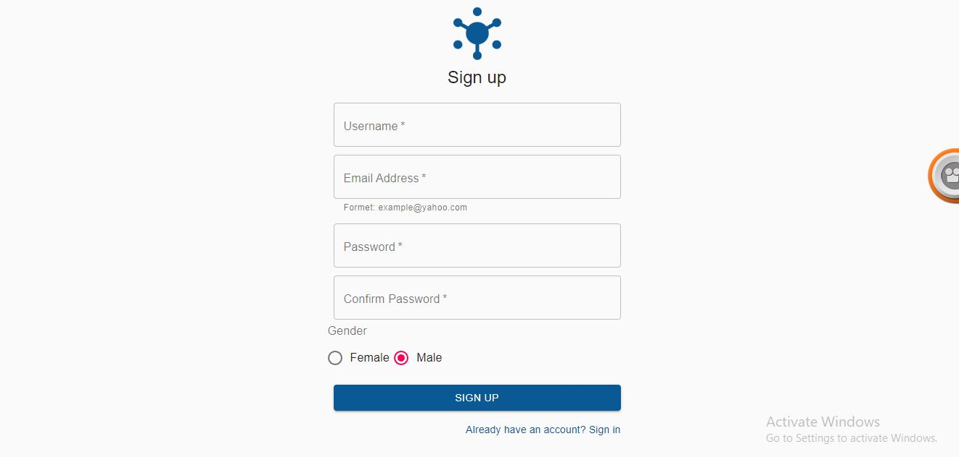
Programming initiative
Mobile app
Web app
10
Notes:
10

Slide 11
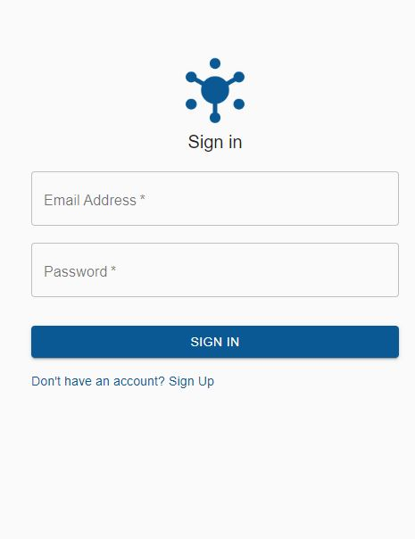
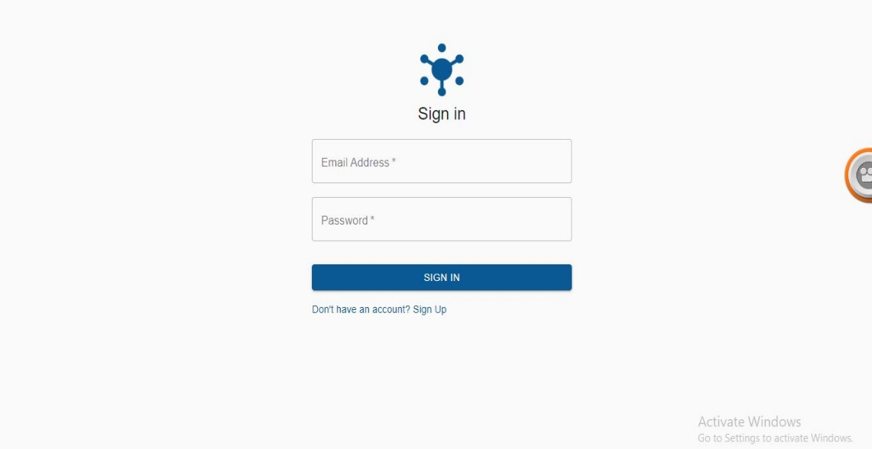
Programming initiative
Mobile app
Web app
11
Notes:
11

Slide 12
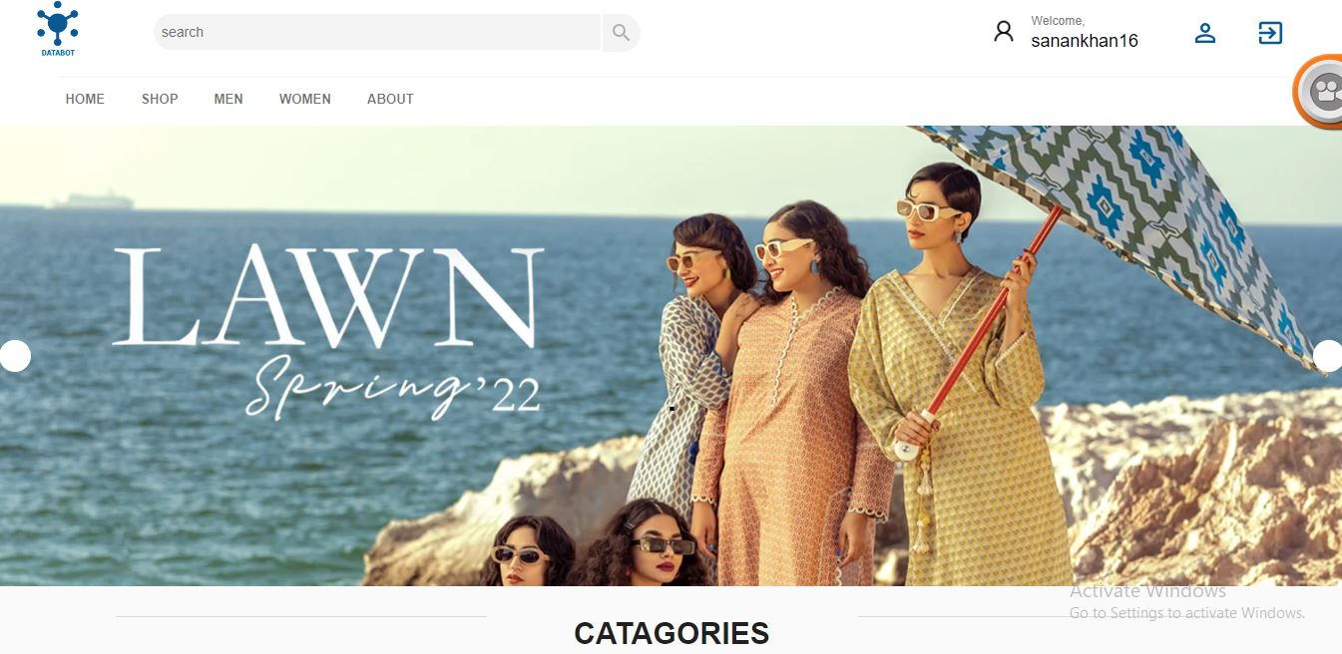
Programming initiative
12
Notes:
12

Slide 13
Project Simulation/Tools
VS Code
JavaScript
React
NodeJS
MongoDB
Github
Netlify
Heroku
13
Notes:
13

Slide 14
Timeline
Activity | Duration
Proposal defense
Requirement Gathering
Design
Implementation
Deployment
Report Writing
 | Jan | Feb | Mar | Apr | May | Jun
14
Notes:
14

Slide 15
References
[1] https://www.farfetch.com/al/shopping/men/items.aspx
[2] https://zasimo.pk/
[3] https://www.lyst.com/
15
Notes:
15

Slide 16
Thank You
16

